Slide 1
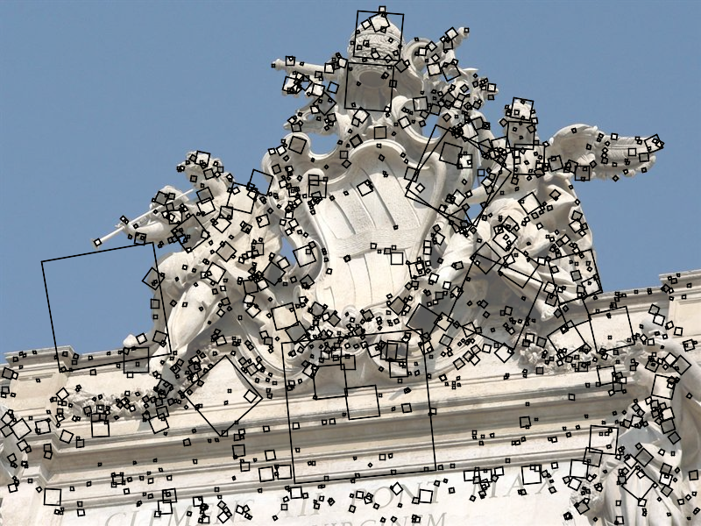
SIFT keypoint detection
D. Lowe, Distinctive image features from scale-invariant keypoints, IJCV 60 (2), pp. 91-110, 2004
Slides from S. Lazebnik.

Slide 2
Keypoint detection with scale selection
We want to extract keypoints with characteristic scales that are covariant w.r.t. the image transformation
Source: L. Lazebnik

Slide 3
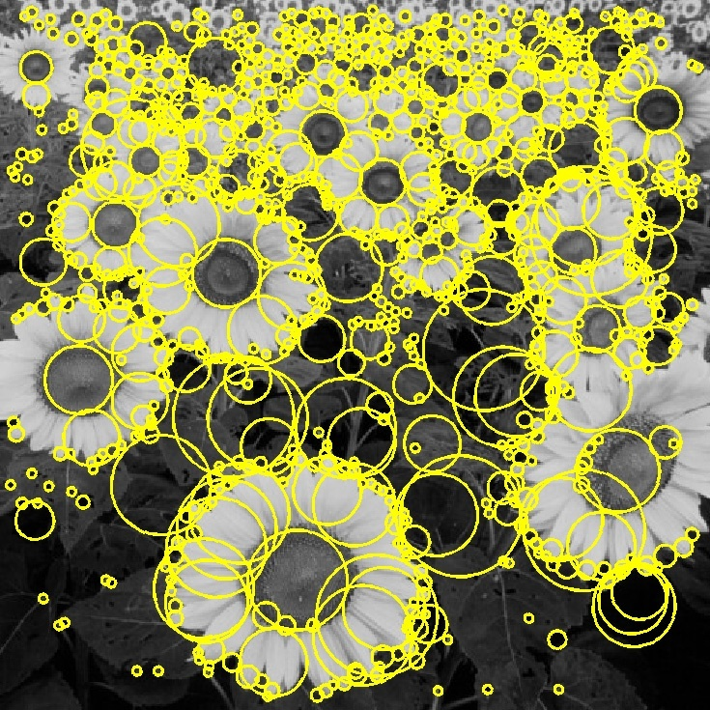

Basic idea
Convolve the image with a “blob filter” at multiple scales and look for extrema of filter response in the resulting scale space
T. Lindeberg, Feature detection with automatic scale selection, IJCV 30(2), pp 77-116, 1998
Source: L. Lazebnik

Slide 4
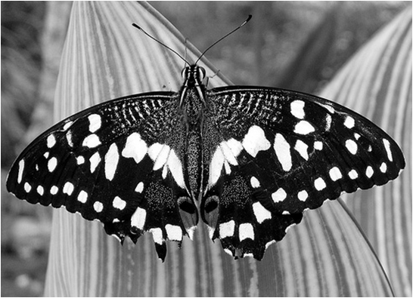
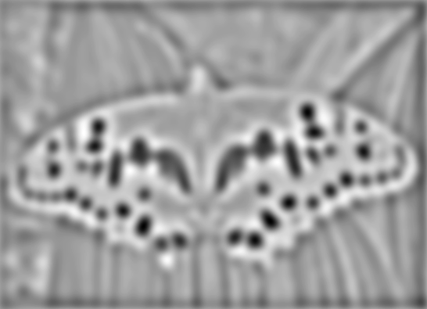

Blob detection
minima
*
=
maxima
Find maxima and minima of blob filter response in space and scale
Source: L. Lazebnik
Source: N. Snavely

Slide 5
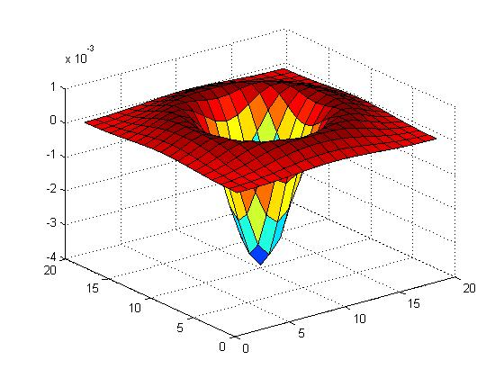
Blob filter
Laplacian of Gaussian: Circularly symmetric operator for blob detection in 2D
Source: L. Lazebnik

Slide 6
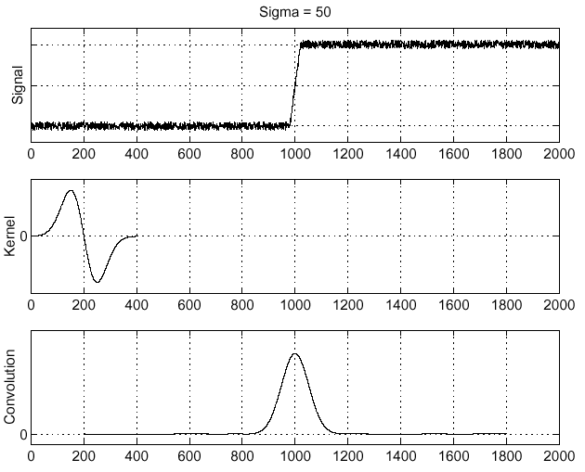
Recall: Edge detection
Edge
f
Derivative of Gaussian
Edge = maximum of derivative
Source: L. Lazebnik
Source: S. Seitz

Slide 7
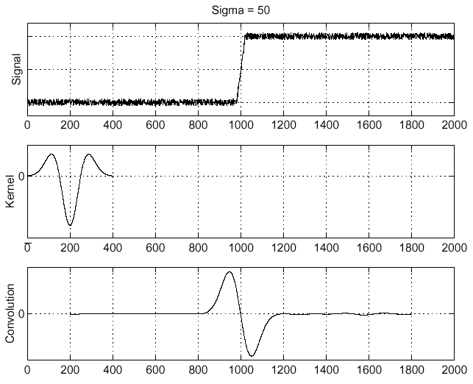
Edge detection, Take 2
f
Edge
Second derivative of Gaussian (Laplacian)
Edge = zero crossing of second derivative
Source: L. Lazebnik
Source: S. Seitz
Notes:
An edge filtered with the Laplacian of Gaussian is the difference between the blurry edge and the original edge.

Slide 8
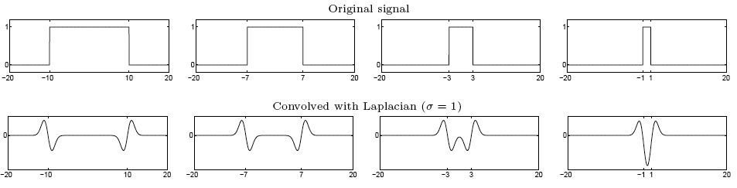
From edges to blobs
Edge = ripple
Blob = superposition of two ripples
maximum
Spatial selection: the magnitude of the Laplacian response will achieve a maximum at the center of the blob, provided the scale of the Laplacian is “matched” to the scale of the blob
Source: L. Lazebnik

Slide 9
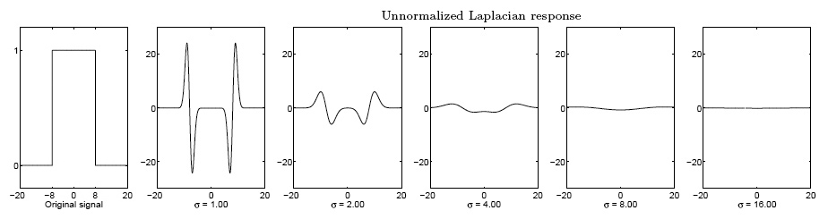
Scale selection
We want to find the characteristic scale of the blob by convolving it with Laplacians at several scales and looking for the maximum response
However, Laplacian response decays as scale increases:
original signal (radius=8)
increasing σ
Source: L. Lazebnik

Slide 10
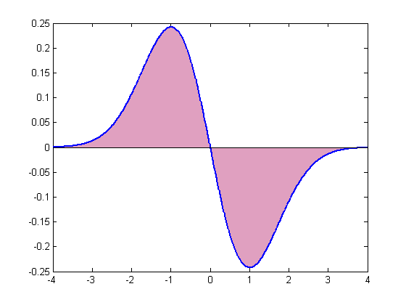
Scale normalization
The response of a derivative of Gaussian filter to a perfect step edge decreases as σ increases:
To keep response the same (scale-invariant), must multiply Gaussian derivative by σ
Laplacian is the second Gaussian derivative, so it must be multiplied by σ²
Source: L. Lazebnik
Notes:
The area under the first derivative of Gaussian from –infinity to 0 is equal to the value of the Gaussian at zero

Slide 11
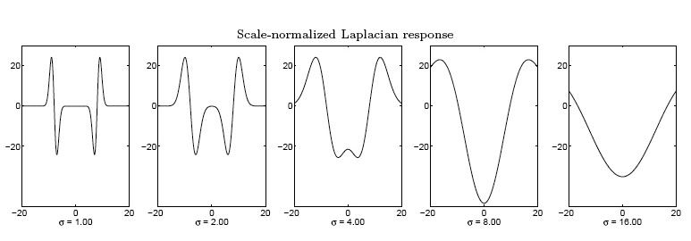
Effect of scale normalization
Original signal
Unnormalized Laplacian response
Scale-normalized Laplacian response
maximum
Source: L. Lazebnik

Slide 12
Blob detection in 2D
Scale-normalized Laplacian of Gaussian:
Source: L. Lazebnik

Slide 13
Blob detection in 2D
At what scale does the Laplacian achieve a maximum response to a binary circle of radius r?
r
image
Laplacian
Source: L. Lazebnik

Slide 14
Blob detection in 2D
At what scale does the Laplacian achieve a maximum response to a binary circle of radius r?
To get maximum response, the zeros of the Laplacian have to be aligned with the circle
The Laplacian is given by (up to scale):
Therefore, the maximum response occurs at
circle
r
0
Laplacian
image
Source: L. Lazebnik

Slide 15
Scale-space blob detector
Convolve image with scale-normalized Laplacian at several scales
Source: L. Lazebnik

Slide 16
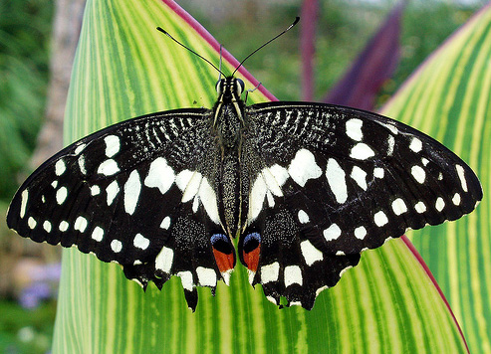
Scale-space blob detector: Example
Source: L. Lazebnik

Slide 17
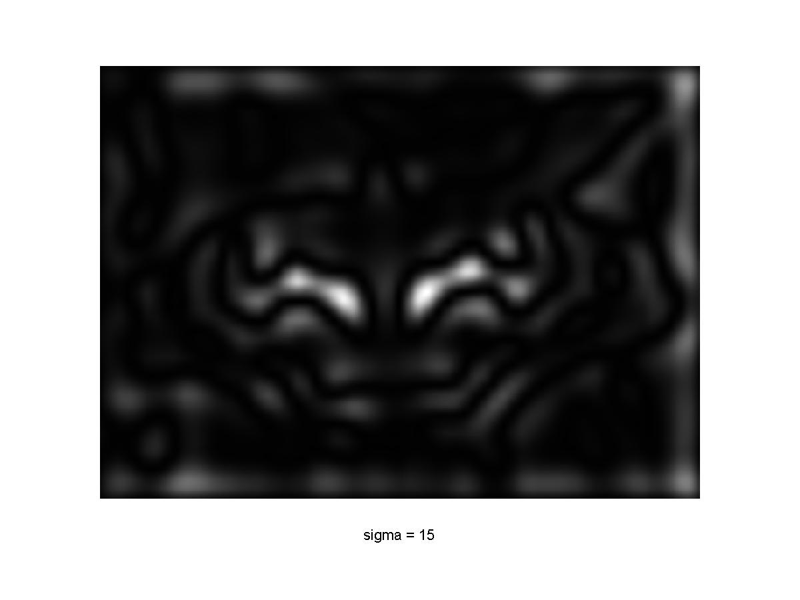
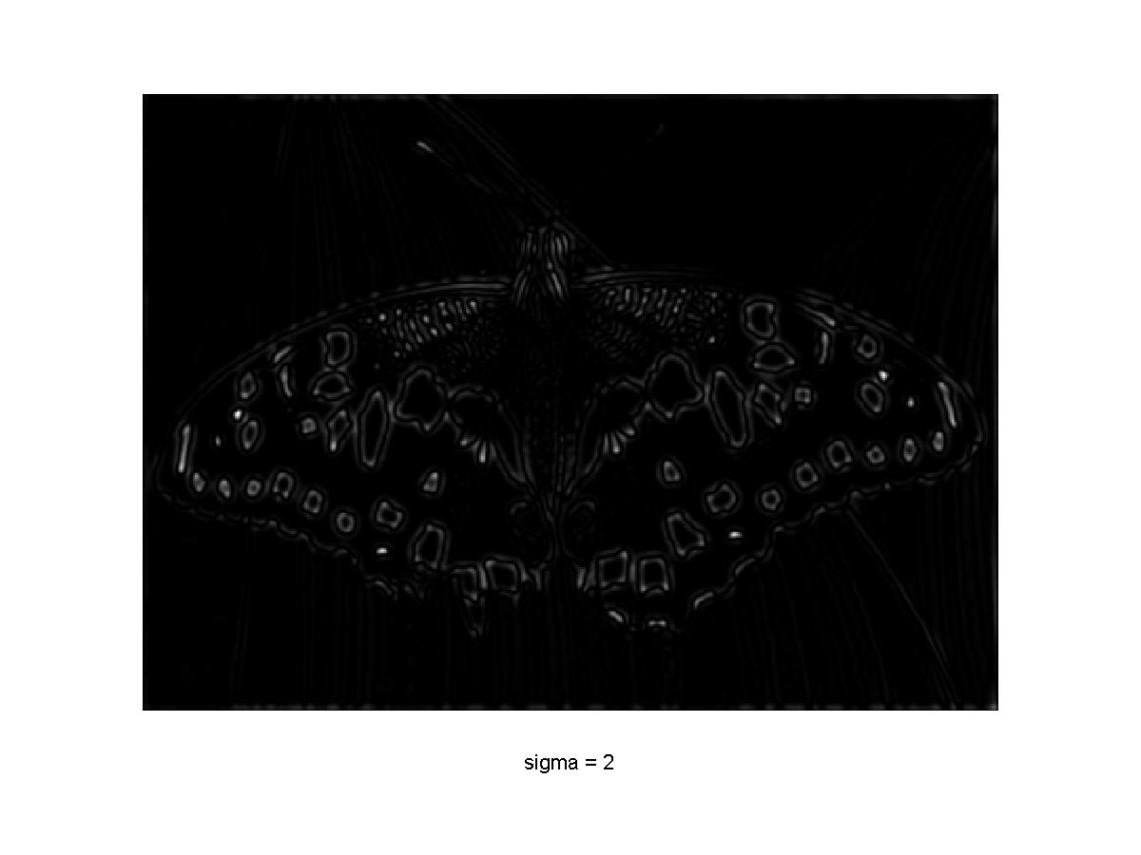
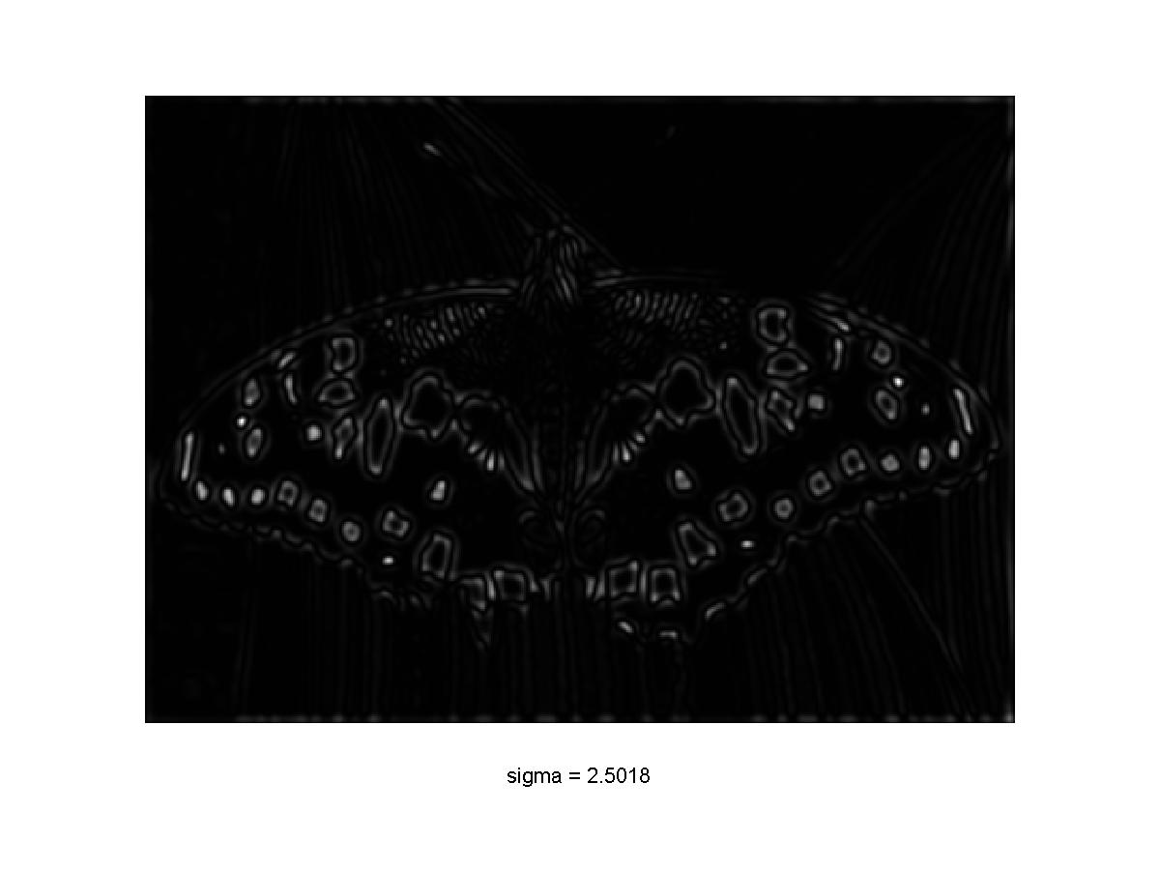
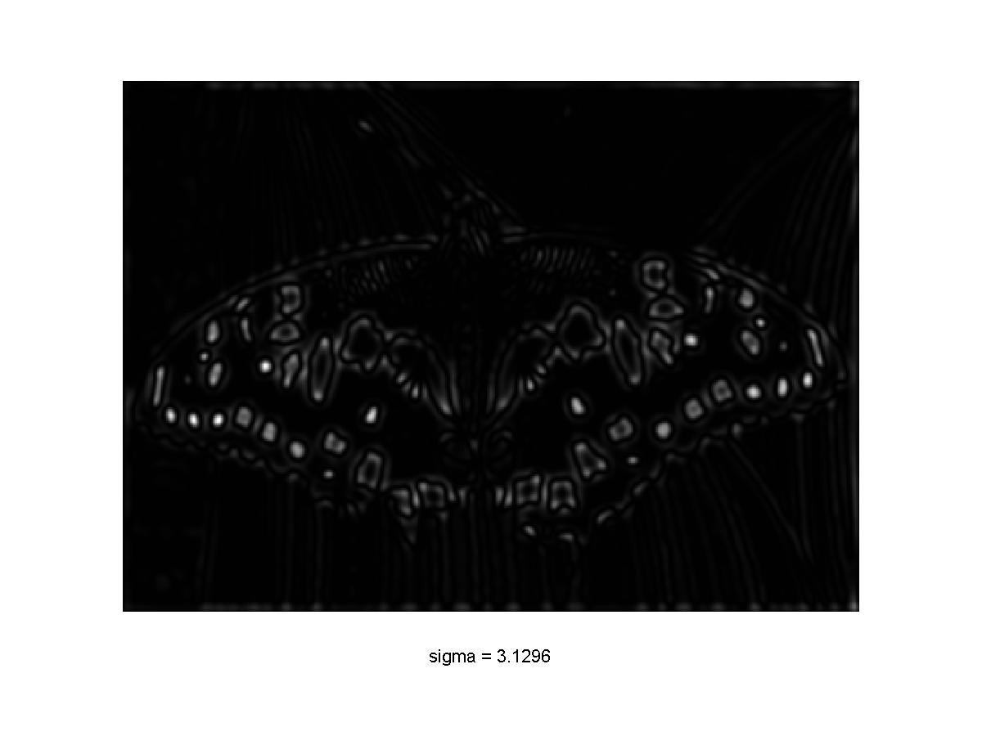
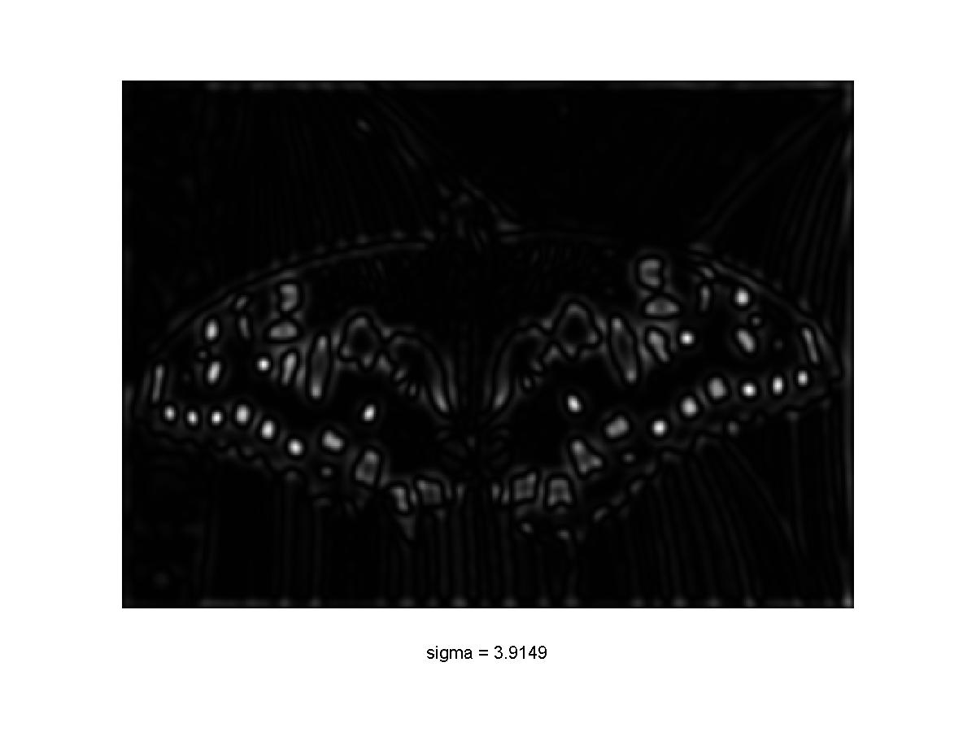
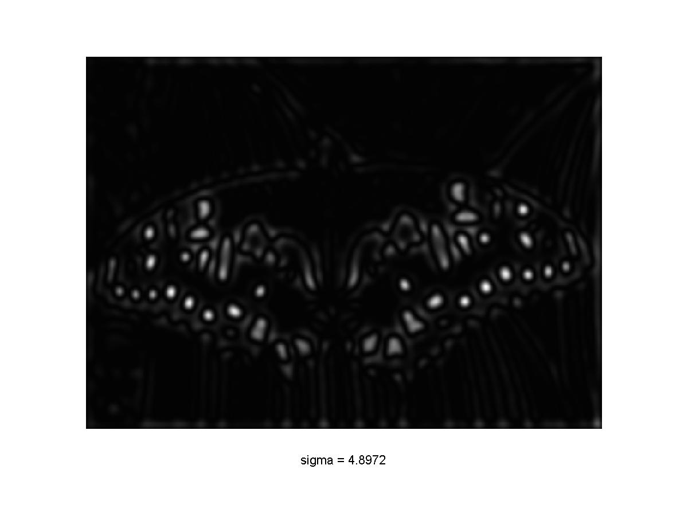

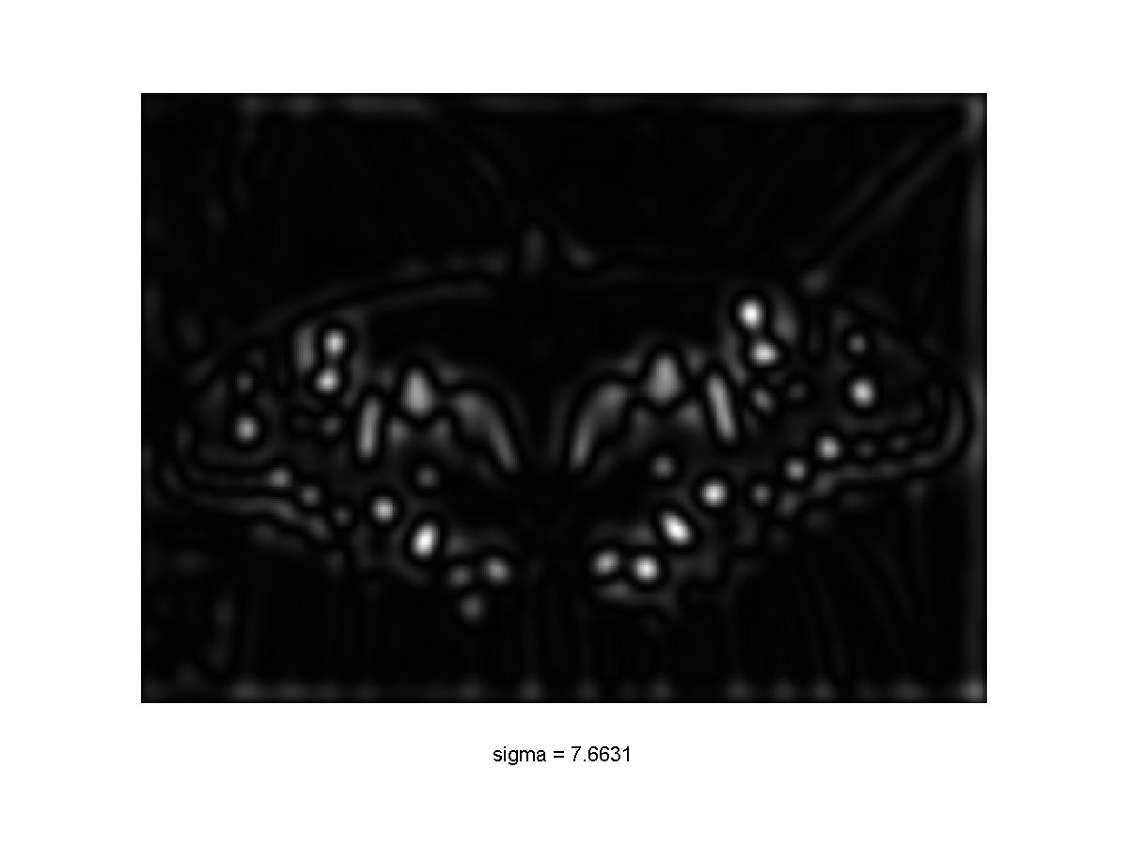
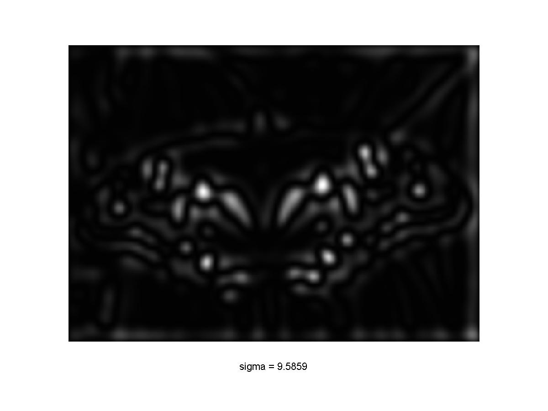
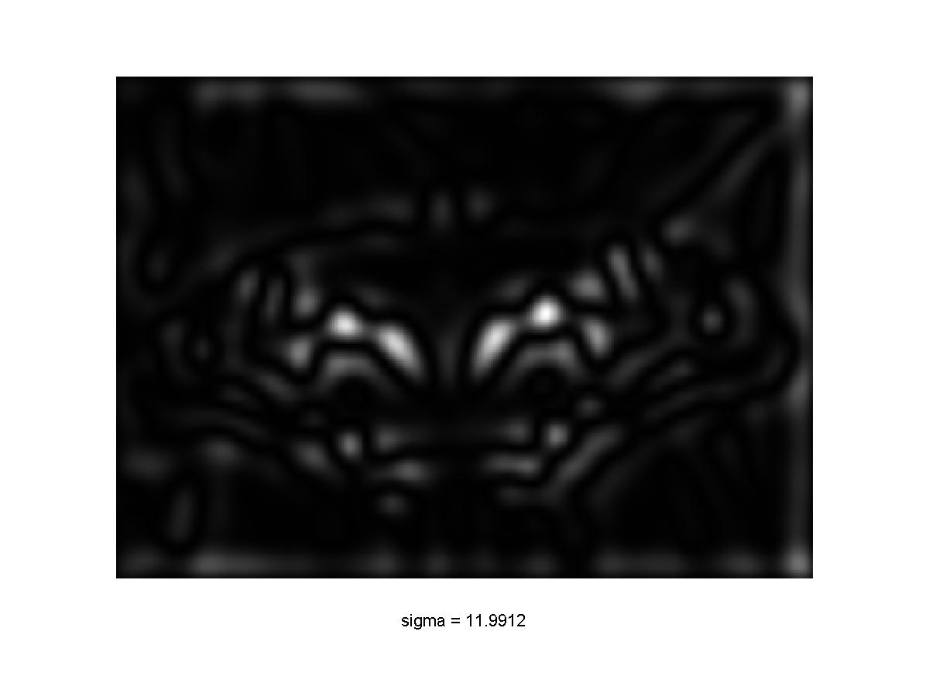
Scale-space blob detector: Example
Source: L. Lazebnik

Slide 18
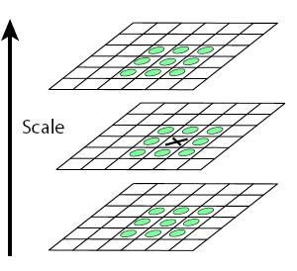
Scale-space blob detector
Convolve image with scale-normalized Laplacian at several scales
Find maxima of squared Laplacian response in scale-space
Source: L. Lazebnik

Slide 19
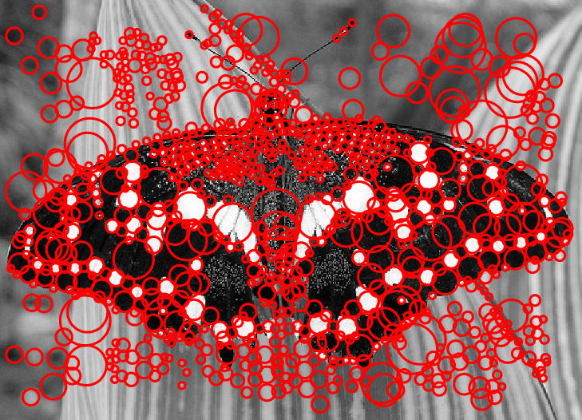
Scale-space blob detector: Example
Source: L. Lazebnik

Slide 20
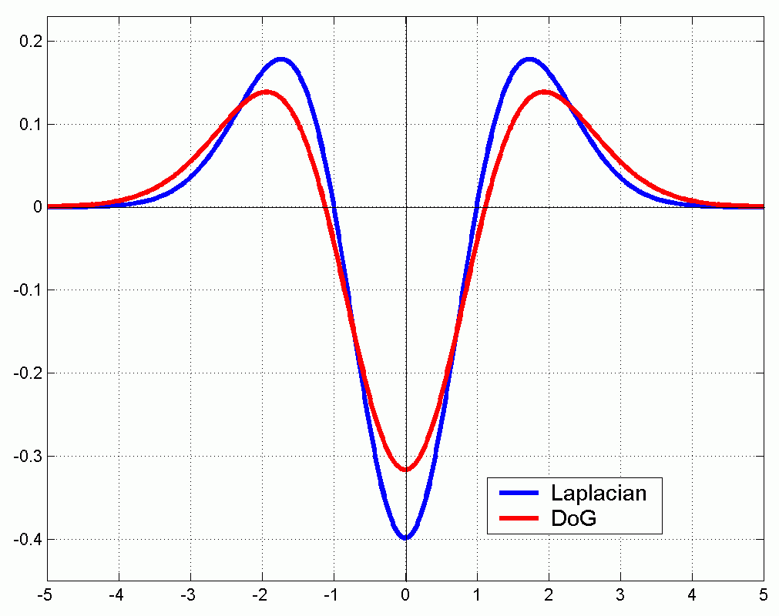
Efficient implementation
Approximating the Laplacian with a difference of Gaussians:
(Laplacian)
(Difference of Gaussians)
Source: L. Lazebnik

Slide 21
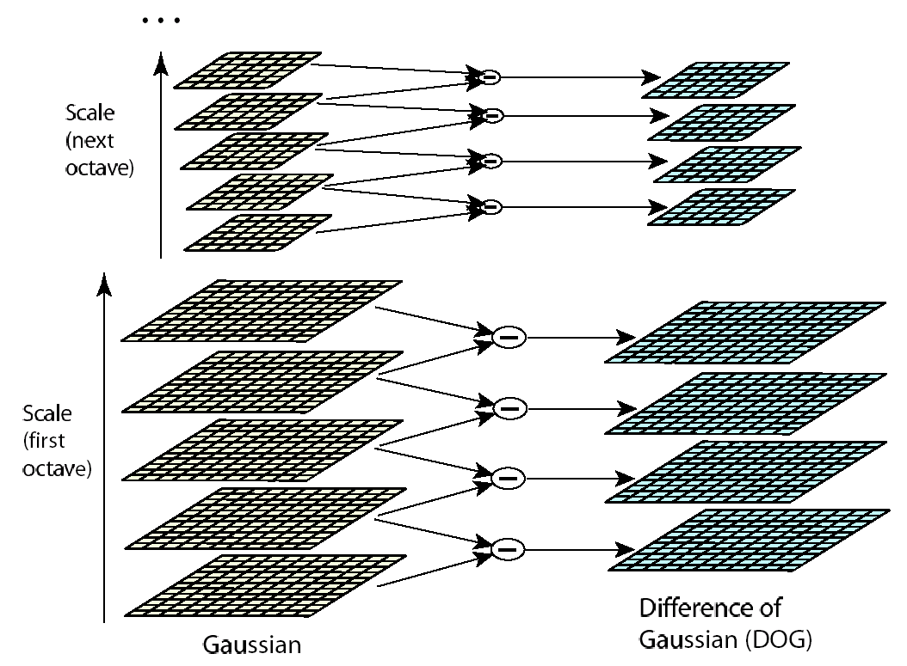
Efficient implementation
David G. Lowe. "Distinctive image features from scale-invariant keypoints.” IJCV 60 (2), pp. 91-110, 2004.
Source: L. Lazebnik

Slide 22
Eliminating edge responses
Laplacian has strong response along edges
Source: L. Lazebnik

Slide 23
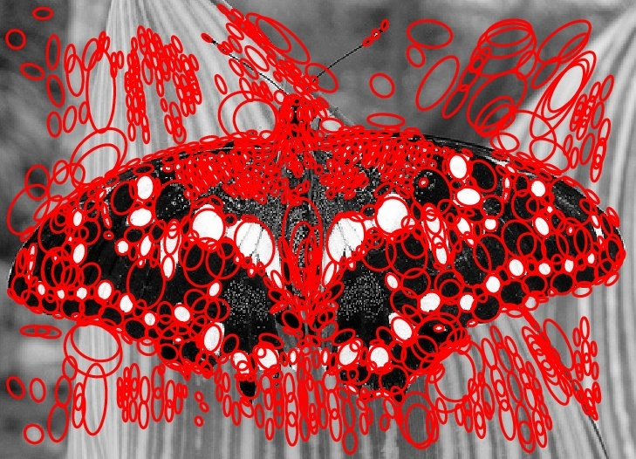
Eliminating edge responses
Laplacian has strong response along edges
Solution: filter based on Harris response function over neighborhoods containing the “blobs”
Source: L. Lazebnik

Slide 24
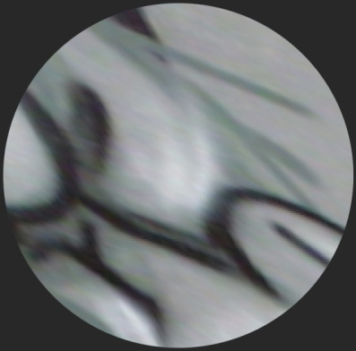
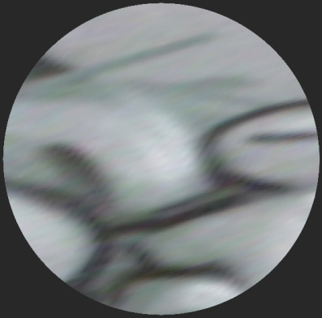
From feature detection to feature description
To recognize the same pattern in multiple images, we need to match appearance “signatures” in the neighborhoods of extracted keypoints
But corresponding neighborhoods can be related by a scale change or rotation
We want to normalize neighborhoods to make signatures invariant to these transformations
Source: L. Lazebnik

Slide 25

Finding a reference orientation
Create histogram of local gradient directions in the patch
Assign reference orientation at peak of smoothed histogram
0
2
π
Source: L. Lazebnik

Slide 26
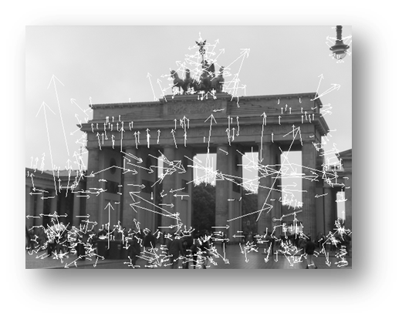
SIFT features
Detected features with characteristic scales and orientations:
David G. Lowe. "Distinctive image features from scale-invariant keypoints.” IJCV 60 (2), pp. 91-110, 2004.
Source: L. Lazebnik

Slide 27
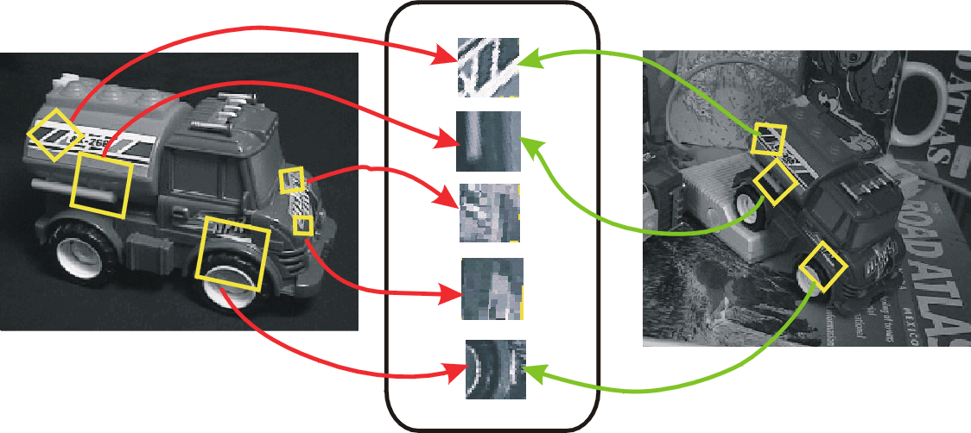
From keypoint detection to feature description
Detection is covariant:
features(transform(image)) = transform(features(image))
Description is invariant:
features(transform(image)) = features(image)
Source: L. Lazebnik

Slide 28
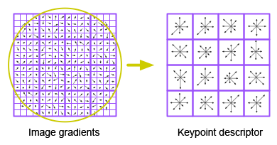
SIFT descriptors
Inspiration: complex neurons in the primary visual cortex
D. Lowe, Distinctive image features from scale-invariant keypoints, IJCV 60 (2), pp. 91-110, 2004
Source: L. Lazebnik
Notes:
From the paper:
The previous operations have assigned an image location, scale, and orientation to each keypoint. These parameters impose a repeatable local 2D coordinate system in which to describe the local image region, and therefore provide invariance to these parameters. The next step is to compute a descriptor for the local image region that is highly distinctive yet is as invariant as possible to remaining variations, such as change in illumination or 3D viewpoint. One obvious approach would be to sample the local image intensities around the keypoint at the appropriate scale, and to match these using a normalized correlation measure. However, simple correlation of image patches is highly sensitive to changes that cause misregistration of samples, such as affine or 3D viewpoint change or non-rigid deformations. A better approach has been demonstrated by Edelman, Intrator, and Poggio (1997). Their proposed representation was based upon a model of biological vision, in particular of complex neurons in primary visual cortex. These complex neurons respond to a gradient at a particular orientation and spatial frequency, but the location of the gradient on the retina is allowed to shift over a small receptive field rather than being precisely localized. Edelman et al. hypothesized that the function of these complex neurons was to allow for matching and recognition of 3D objects from a range of viewpoints. They have performed detailed experiments using 3D computer models of object and animal shapes which show that matching gradients while allowing for shifts in their position results in much better classification under 3D rotation. For example, recognition accuracy for 3D objects rotated in depth by 20 degrees increased from 35% for correlation of gradients to 94% using the complex cell model. Our implementation described below was inspired by this idea, but allows for positional shift using a different computational mechanism.

Slide 29
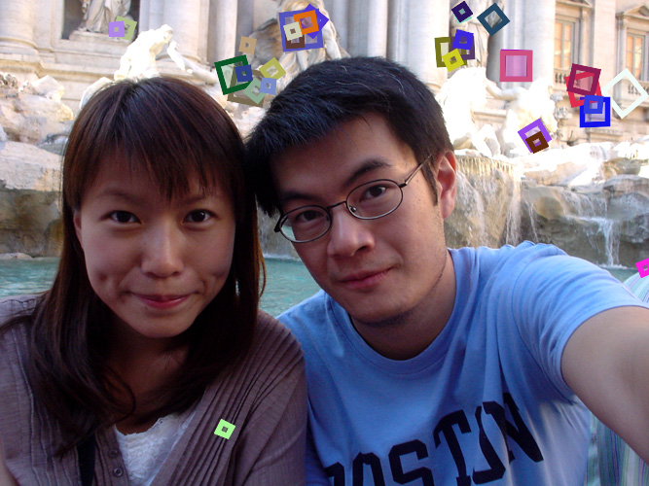
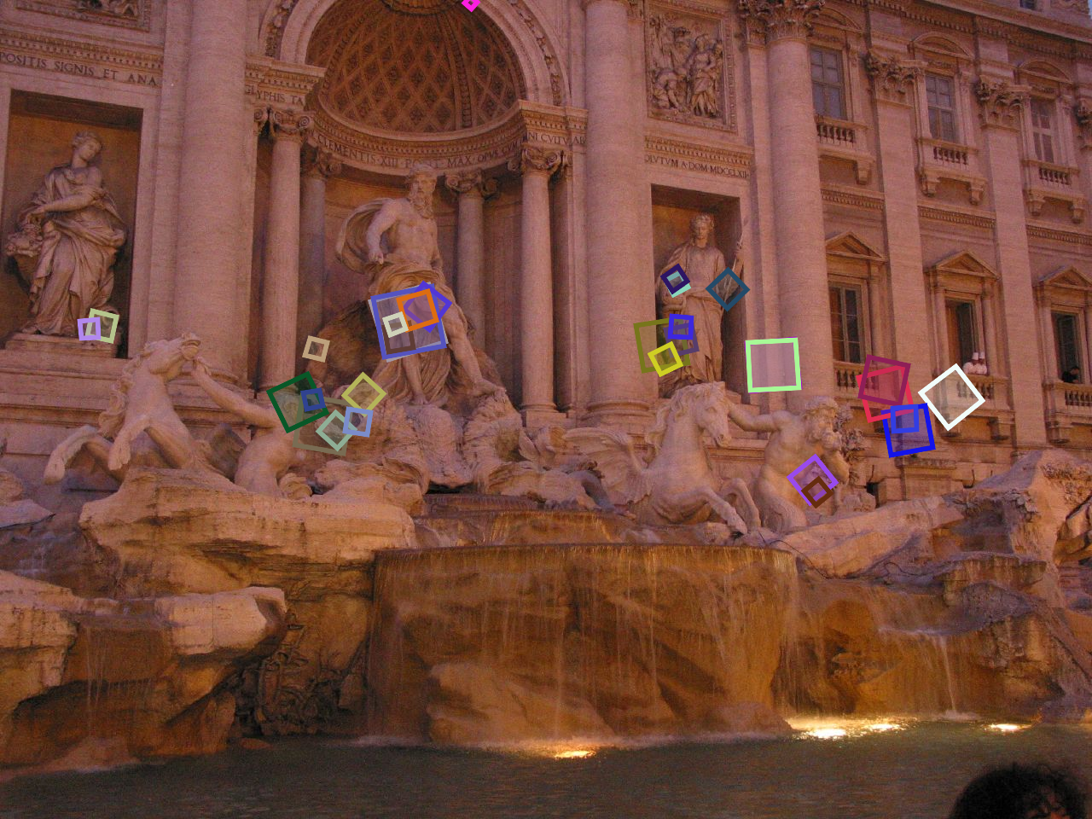
Properties of SIFT
Extraordinarily robust detection and description technique
Can handle changes in viewpoint
Up to about 60 degree out-of-plane rotation
Can handle significant changes in illumination
Sometimes even day vs. night
Fast and efficient—can run in real time
Lots of code available
Source: N. Snavely

